Slide 1
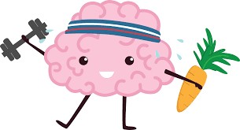
‘Helping Your Child Thrive’ Workshop for Parents
Jemma Leslie - Children & Young
People’s Wellbeing Practitioner
(CYWP)
Beth Craig -Education Mental Health Practitioner
(EMHP)
Mental Health Support Team,
Wirral Child and Adolescent Mental Health Service (CAMHS)
Notes:
Introductions, names, housekeeping
Explain the workshop is called ‘Thrive’ as it was chosen by a group of parents that our service did work with. . .workshop 1 hr long plus time for questions Mention Feedback form on desk, parents need to rate themselves at the beginning and then at the end.

Slide 2


Group Rules
Confidentiality
Respect
Non judgemental
Listen
Ask questions!
Difficult conversations
You’re doing a great job!
Notes:
(go through the list. . . any other things people would like us to add or consider?) REMEMBER TO KEEP YOURSELF SAFE, ONLY SHARE WHAT YOU WANT
Confidentiality – what we talk about stays in here
Respect – we may all have different views on things, important that we respect each others views and how we live each other’s lives
Non judgemental – we aren’t here to judge people or discriminate against each other
Listen – we can learn so much from each other, important to listen to each other and be patient
Ask questions - If you’re not sure, just ask! Cliché but no such thing as silly question, only way we learn
Difficult conversations – please protect yourself, only share what you feel comfortable with
You’re doing a good job! –coming here today means you are doing a great job and that you want to continue to keep you and your child happy and healthy both physically and mentally. Often we can be too self critical, no one has ever got the perfect child and likewise, there’s no such thing as the perfect parent, we are learning on the job!!

Slide 3

What to Expect from Today…
Ideas on how to build your child’s resilience
To know what to look out for regarding your child’s mental health
Ideas on talking to your child about mental health
Who to speak to if you need more help
Notes:
The aim of the Workshop is to give you a general overview about mental health in children and give you some guidance about how to help your child build resilience.
Remember, no one is an expert its about building on what you know and the individual needs of your child. . . .Sharing ideas in a group can help others

Slide 4
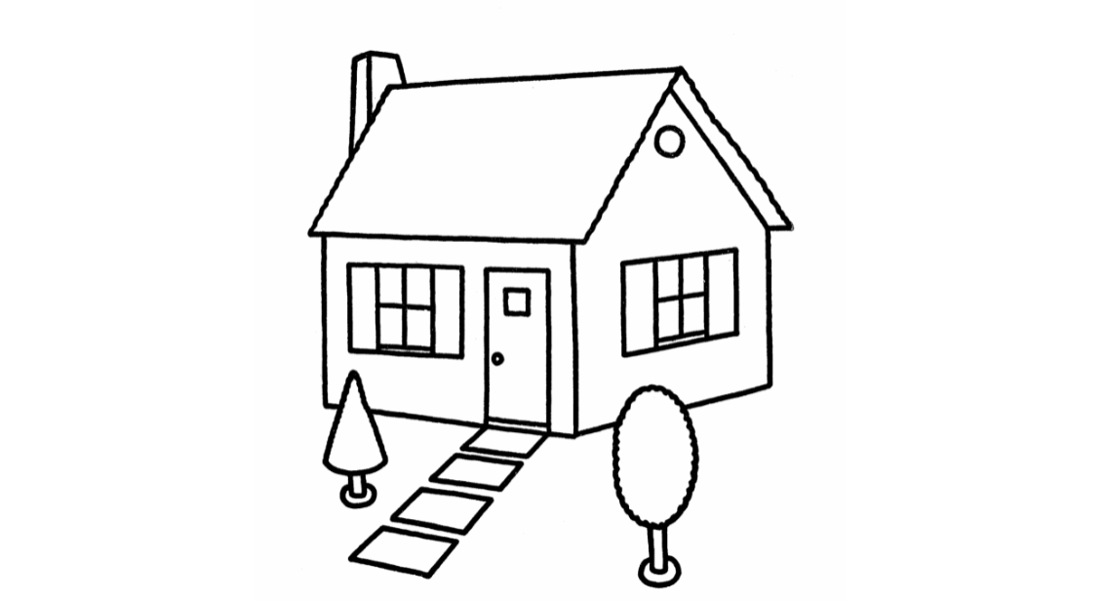


Inpatient Services
LD CAMHS
0-18 CAMHS
Access Team & Mental Health Support Team
Referral Process
Notes:
We are the MHST, which comes under the Access Team. Explain our role in primary schools and that we offer low level psychological interventions to CYP with ‘Mild’ mental health difficulties eg anxiety/worries/low mood. CAMHS (0-18 Team) is a specialist mental health service for children who need a specialist service/ support with mental health 9moderate to severe mental ill health)
Referral process – via mental health lead in school, GP, professional involved in your child’s care and or completing a Request for Help form online
Offer training/ consultations with professionals working with young people and families
Mental Health is everybody’s business – school, Family, community, children themselves

Slide 5

What is Positive Mental Health?
Develop and thrive 😊
Make and keep friends, and understand what makes a good friend 👭
Use and enjoy time on our own🧘‍♀️
Empathise with others💕
Play and learn🎲🤔
Develop a sense of right and wrong 👍👎
Resolve problems and setbacks and learn from them🤔😀
Notes:
Positive mental health is not about being happy, it consists of all these things for a child to Thrive.
it is about being able to cope with difficulties

Slide 6

Children with
Additional Needs
May no be aware of their own mental health or understand what is happening
Struggle to communicate how they are feeling
Struggle to cope with difficult feelings
Think about or follow plans/instructions to improve their mental health
Therefore we might see more challenging behaviour or more signs of distress
Notes:
There’s a whole spectrum of additional needs. This may include dyslexia, social and communication difficulties, Autism, ADHD or it may be more severe a child may have a diagnosed Learning Disability or Global Developmental Delay. There’s support from schools via SENCO, Children’s centres and social care to help with children with additional needs. We also specialist teams within CAMHS ie Learning Disability Team and Neurodevelopment team.
Children with additional needs might find it harder to communicate and it may be as a parent you notice a change in the way your child behaves eg loss of appetite , withdrawn at school or sleeping difficulties.

Slide 7
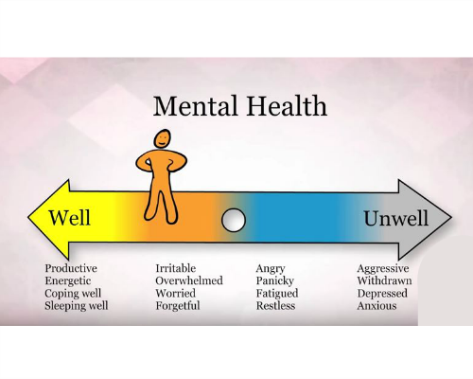
What is Mental Health?
Notes:
Mental health continuum – we are all on here (CYP & parents) and we can all move up and down the continuum constantly depending on what things are going on. We’ll discuss what factors can influence in a bit

Slide 8

What is Resilience?
Notes:
What does it mean if someone is very resilient?? Ask around the room for suggestions . .NEXT SLIDE Definition

Slide 9

What is Resilience?
Resilience: ‘the capacity to recover quickly from difficulties; toughness.’ (Oxford English Dictionary)
What Does Resilience Mean to Young People? https://youtu.be/4RzHx5rw0f4
Are children today resilient?
Notes:
(Read out definition of Resilience) 5 mins discussion group
This is the link to a video on resilience made by charity, Headspace, its just brief clips of young people (probably high school age) explaining what they think resilience is (watch 3 min video)
So, Resilience means ability to bounce back, to adapt to circumstances, keep trying and not give up, to face adversity and grow from it, rise to the challenge
Are children resilient today – in pairs how is parenting now different from when we were kids? Give 5 MINS

Slide 10

Are children resilient today ?
Notes:
Ask the group, are children resilient today ? how is parenting now different from when YOU were children?
(they may talk about social media changing things, expectations in school have increased, more pressure, different parenting styles when they were little?

Slide 11
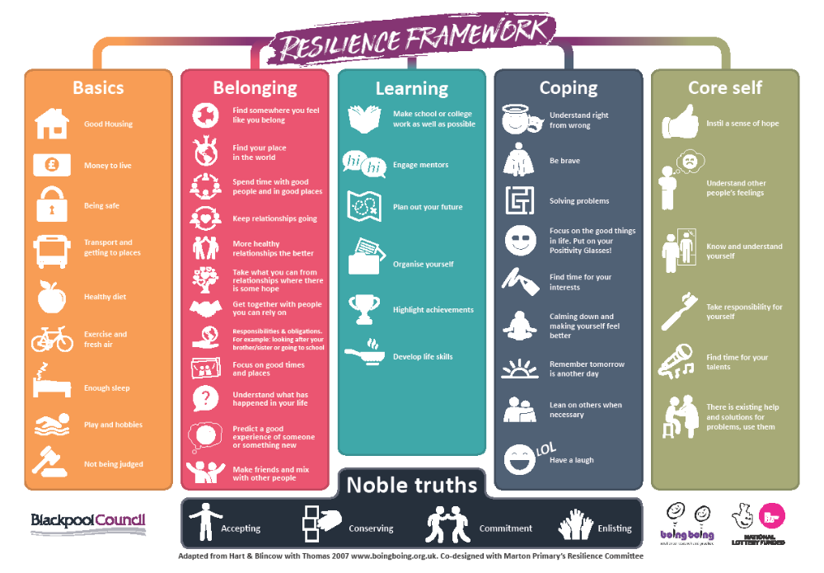
www.boingboing.org.uk
Notes:
The Resilience Framework has been put together by an organisation called Boingboing using lots of evidence based research and data gathered from experienced professionals who work in communities, many of the communities very deprived.
We have copies of this if you want to take it home have a think about all the components of the resilience framework.
Please see their website www.boingboing.org.uk for further information about the framework and strategies to improve resilience within the community

Slide 12

5 Ways to Mental Wellbeing for parents
Connect – with other people, talk, spend time with family and friends
Be Active – physical exercise, walking,
Take Notice – ‘Be in the moment’, notice what’s going on around you in the present
Learn – do a crossword, read a book, learn a new skill, attend a workshop!
Give – help others, engage in your community
Notes:
Important for parents to stay mentally well in order to increase childs protective factors
what can we do to look after our mental wellbeing? Any other suggestions or what have you found helpful??
Mindfulness?? Parenting group??
FOOD AND MOOD – important how eating can improve mood – vitamins minerals and evidence suggests eating food with colour can help with mood

Slide 13
The Stress Bucket
Stress flows into the bucket
If the bucket overflows, problems develop - “snapping”
Vulnerability is shown by the size of the bucket
Helpful coping strategies = tap working lets the stress out
Unhelpful coping strategies = tap blocked so water fills bucket and overflows
13
Notes:
When we are busy with family life, we don’t realise how much stuff we have going on. . . . .Ask to shout out stresses, also to share positive and negative strategies used talk about strategies to help, talking exercising, fidget toys, Mindfulness etc
(blank stress bucket on Next slide or can hand out to take home?)

Slide 14
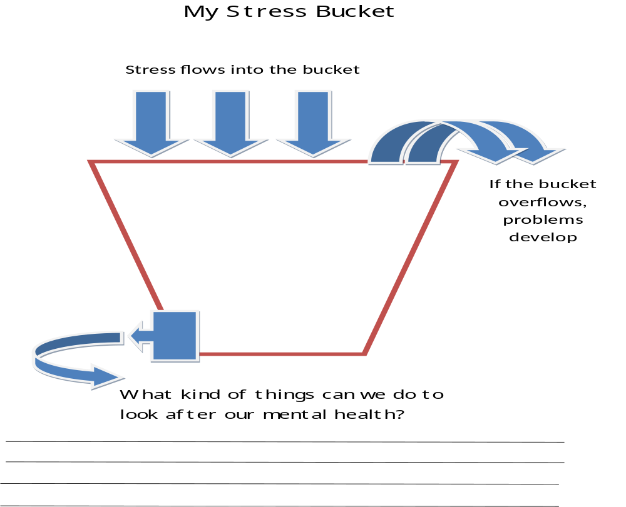
Notes:
Children can feel overwhelmed, stressed, anxious, panicky. THINGS THAT CAN HELP, Deep breaths, 5 Finger breathing, Anxiety sheet, grounding technique, distractions, Stay Calm box (include favourite things, stress toys etc). Explain you have some handouts to explain how to use these strategies at the end

Slide 15

What Helps?
Think of a time you have recovered from something (illness, life event, etc). What helped you recover?
Notes:
(Hand out post it notes across the tables with pens)
Think of when you recovered from something (DON’T HAVE TO SAY WHAT IT WAS, KEEP THIS BIT PRIVATE)– could be an injury, illness, mental health difficulty, life event …
What helped your recovery – write 3 things down on post its and put the post it on a board in the room (or trainer collect them up)
When everyone has done this trainer read through them, see what the main things/themes are that help us recover.

Slide 16
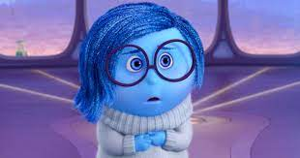
Talking About Mental Health
https://www.youtube.com/watch?v=r_yAtOh3yV0
Anna Freud National Centre for Children and Families www.annafreud.org
Notes:
It’s often difficult talking about difficult emotions and mental health with our children. This is a 5 min video which talks about ways to try and have conversations with your child about how they are feeling. (NB: the picture is The character called ‘Sadness’ from the 2015 Pixar children’s film, "Inside Out“ which is a really good film to get primary school age children identifying and labelling emotions.
At the end of the video, maybe suggest for younger children, it may be that you try and have the conversation when you are watching a kids film with them or maybe drawing, painting or doing play doh with them? ANNA FREUD YOUTUBE CLIP 5.30 MINS

Slide 17


How to Talk and How to Listen
Make talking about mental health a normal everyday part of life
Give it your full attention and take it seriously
Positive body language
Ask open questions
Stay calm
Offer empathy rather than solutions
Encourage your child to think of what might help (give them control)
Notes:
What parents can do? . . .Like the Anna Freud video, make it part of normal routine.
Try modelling positive behaviour with your children
‘Stay Calm’ easier said than done, but children learn from their parents/carers if they have had a minor accident and we overreact that sends a message about how we should deal with situations
NB You may want to print copies of this out to hand out to parents, previous groups found a useful resource

Slide 18

How to Help Your Child
Develop Resilience
  Positive Attention- catch them doing something good, eye contact
  Labelled Praise - be specific about what you have liked i.e. ‘you walked to the house so nicely’, rather than ‘you’ve been good’
  Rewards – more powerful than consequences, keep them realistic
  Enjoyable activities – having fun lifts our mood
  Help them to achieve – builds self esteem
  Plan for success – visual clues, preparation, choices
  Clear boundaries – makes life more predictable
  Help your child to understand / express emotions – Model good communication, set good examples use tools like Worry jars
Notes:
Positive attention- compliment the smallest of things
Labelled praise - important to keep it specific, not vague. . .language you use is clear concise
Rewards - praise and reward the positive behaviour and if they have managed something difficult ie getting into nursery/school, this sends a positive message.– Try and encourage even the smallest things . . .Use rewards immediately after the behaviour
Enjoyable activities - Sometimes it may be hard to find activities your child enjoys, or it can be tricky for them to participate in them regularly. But having fun and doing things we enjoy naturally lifts our mood
Helping your child to achieve manageable goals will build their self-esteem and help to lift their mood . . the goal is achievable and within your child’s capability, do ONE STEP at a time
Plan for success – plan your daily routine, activities and outings to give you and your child the best chance of a successful outcome. . .preparation, visual cues/visual timetables.
Clear boundaries - Having consistent routines and boundaries help children to learn what is expected of them and makes their life more predictable.
CYP Addit Needs – try not to bend the rules/ confusing
Help your child to understand / express emotions - we are role models, label your own emotions, if you notice change, comment e.g. ‘I can see you’re feeling sad that we have to go home.’ By doing these things consistently it will help them understand, manage their emotions and learn how to problem solve themselves
Do you have special time with your child? (ASK group)
then talk about worry jar, give out The Worry Jar leaflet and Self soothe Box
NB You may want to print copies of this out to hand out to parents, previous groups found a useful resource

Slide 19

CAMHS Referral Criteria
Concerns about your child’s emotional wellbeing
Significant anxiety and/or low mood that’s impacting every day life
Regular self harm with thoughts of suicide
Significantly restricting food intake / binge eating
Severe reaction to traumatic event(s)
Notes:
Sometimes input from family might not be enough and it may be that you feel your child may need some support from either school or from specialist services like CAMHS.
Explain this is a brief list of indicators, if any concerns speak to mental health lead within school, gp, any other professionals involved. Self harm and restricting food may be for older children may need core CAMHS. Explain about MHST, parents can speak to MH lead in their child’s school.
Reminder, mental health is on a continuum, it can go up and it can come back down so getting the right help at the right time helps.

Slide 20

Stepped Approach to Supporting Your child
Step 1 – Talk, listen, empathise, encourage your child to find their own solutions and build resilience
Step 2 - MindEd – over 300 topics about mental health for parents (and professionals) www.minded.org.uk
Step 3 - CAMHS website www.mymind.org.uk for resources
Or Complete CAMHS Request for Help Form on the website
Step 4 – Contact our CWP Helpline: 0800 145 6485
Notes:
To recap
Step 1 - Talking to your child about feelings/emotions. Think about how important it is for you to come to this group, when you talk to someone and you feel listened to?
How do you and your child manage your stress buckets? (some resource sheets here
Help your child build resilience - Standing back and allowing your child to sort out their own problems don’t try and ‘fix’ everything for them.
You are the best role model for your child, Managing your own emotions when your child is distressed.
Step 2 & 3 Access more advice if required, via CAMHS, MindEd, Anna Freud Website, we have leaflets you can take if you want called ‘tips for helping talking about MH’
Step 4 - Explain All Age Crisis line – CWP CAMHS helpline available between 24/7
Leaflets about advice line available and leaflets about talking about mental health

Slide 21
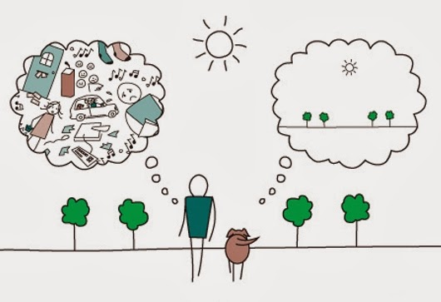
Mindfulness
3 min body scan
https://www.youtube.com/watch?v=ihwcw_ofuME
Notes:
Anyone used Minfulness??
(use this one or read one out??) Explain that Mindfulness allows the voices to be there but allows you to say to yourself, I’m not dealing with that right now. Recognising things that have happened in the PAST that you cannot change and we don’t want to worry about the FUTURE, things that may or may not happen. We want to focus on the PRESENT, stay in the moment.
Also, they can download Headspace on your phone or search Mindfulness videos on YouTube

Slide 22

Resources to to help!
Notes:
Have some of the resources printed out eg Square breathing . . Finger breathing . . .anna freud website . . .ways to talk (Slide 17). . How to build resilience?(slide 18)

Slide 23
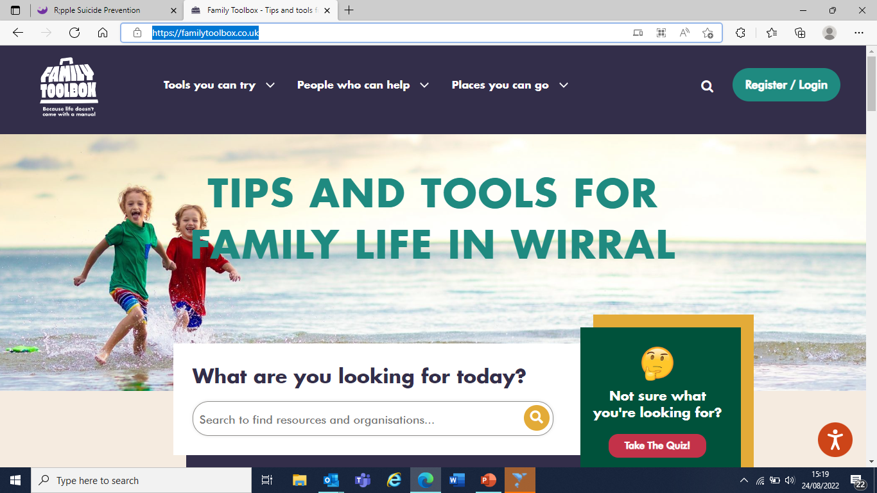
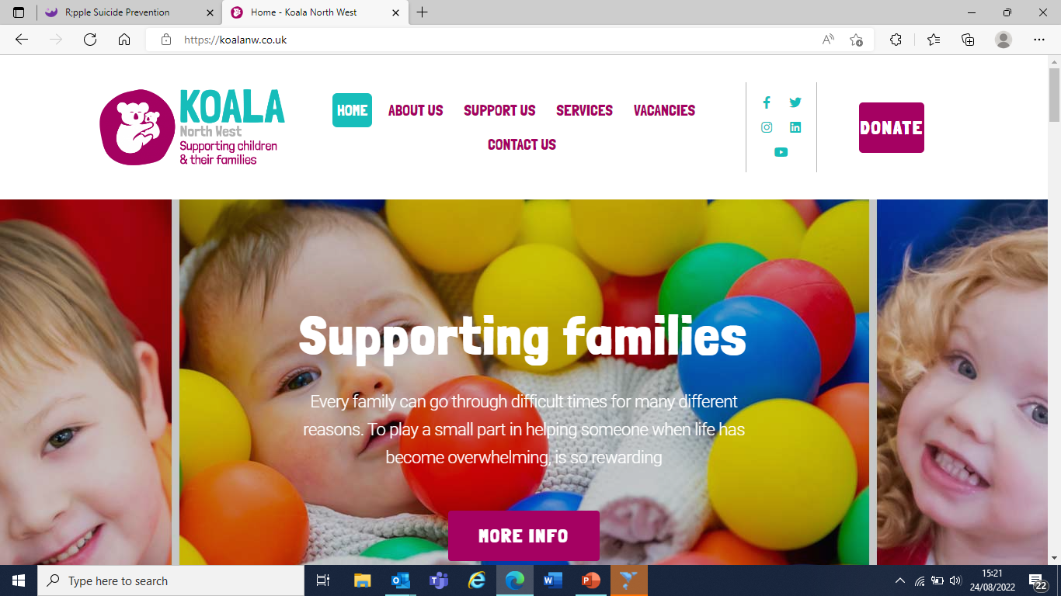
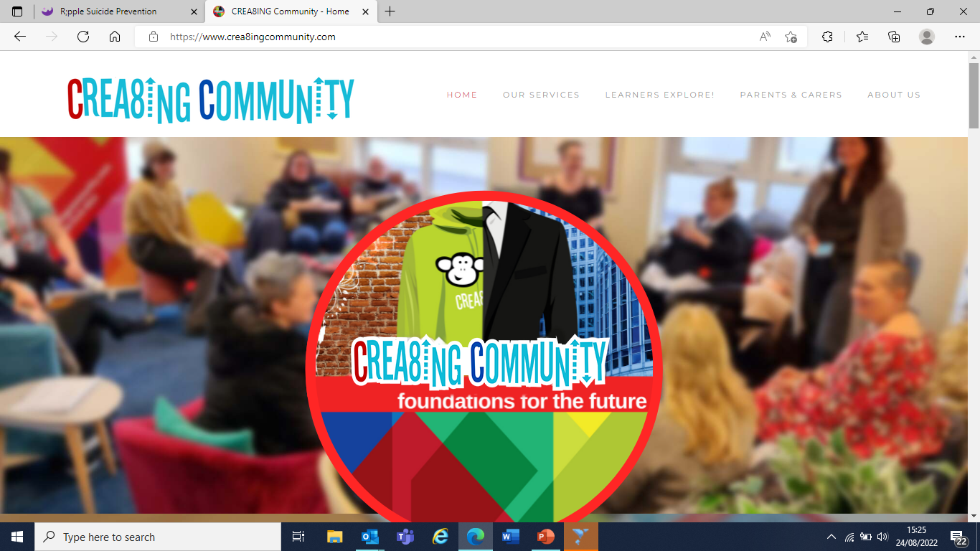
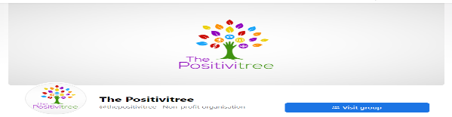
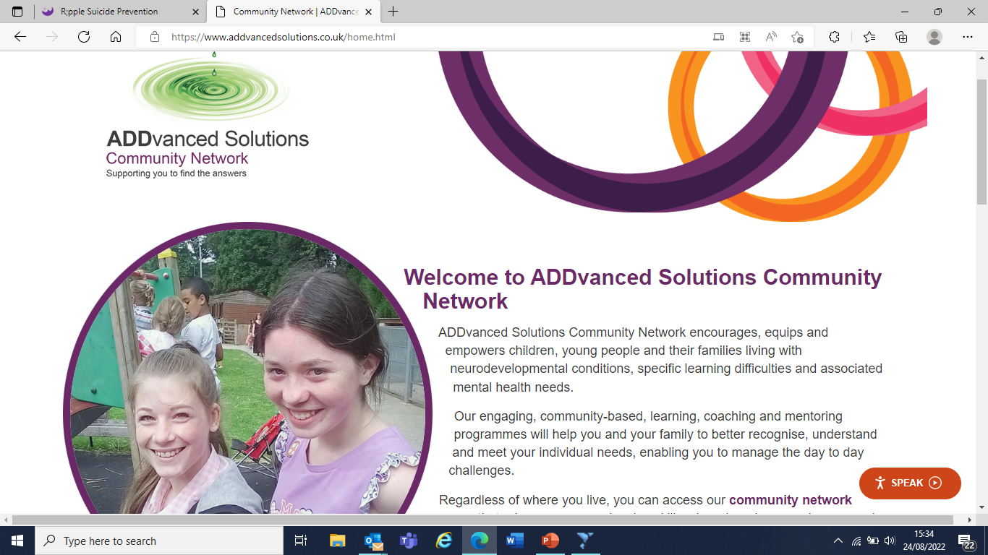
Support for your family
Family Tool Box
https://familytoolbox.co.uk/
Koala North West
https://koalanw.co.uk/
Crea8ing Community
https://www.crea8ingcommunity.com
Positivitree
https://en-gb.facebook.com/thepositivitree/
ADDvanced Solutions Community Network
https://www.addvancedsolutions.co.uk
Notes:
Positivitree - parent support group with a child with additional needs (either physical disabilities or neurodiverse diagnoses’)
https://en-gb.facebook.com/thepositivitree/
NB mention that ADDvanced solutions not currently offering workshops on the Wirral but Koala North West and Crea8ing community do, go to Family Tool Box for more details or the websites mentioned above.

Slide 24

How confident do you feel now helping your child manage their anxiety or worries?
Notes:
Can everyone fill in the level of confidence and complete the rest of feedback form please can put name or leave anonymous.

Slide 25


Finished!
Any questions?
Please complete evaluation form
Notes:
Any Qs, thank everyone, try and make use of the Mymind website.#
Rachel/MHST will continue to be involved with your service/school, you can speak to the Mental Health Lead (ie SENCO or Deputy Head) in your school if you think your child might need support from our team

